Slide 1
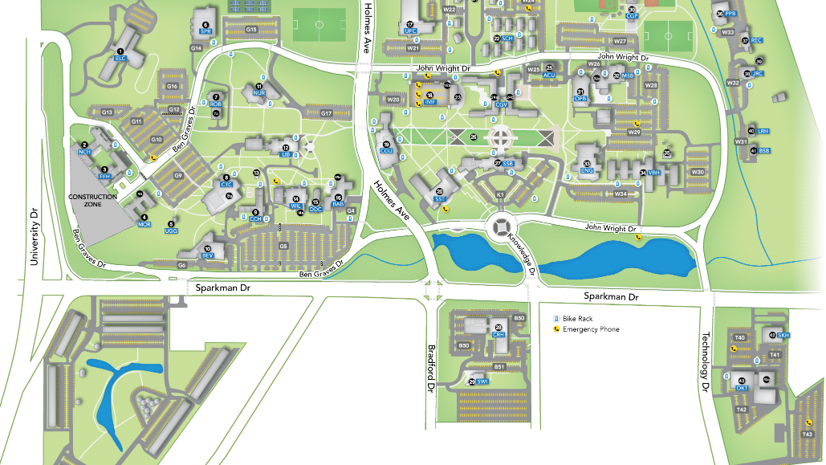
AADL Meeting
Feb 11-13
The M‐50 Conference Room is
located here (Von Braun Research
Hall item 34) on the second floor.
Parking only on the South Side of
the building – Come in the glass
doors and go down the hall until
you get to where the hallways
meet. Take the stairs at the
intersection of the hallways and M‐
50 is to the right of the bathrooms.
AADL Meeting
Von Braun Hall
(34) Auditorium

Slide 2
AADL Demo Day
Feb 14
AM Presentations
Charger Union
(19) Theater
PM Demos CTC
Exhibit Hall 8a
All Day Parking
Feb 14, 15 AM

Slide 3
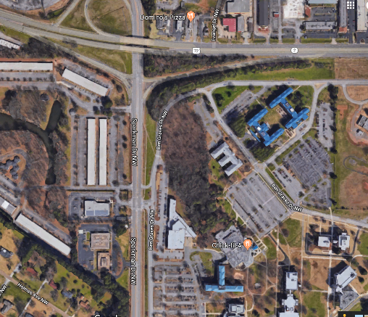
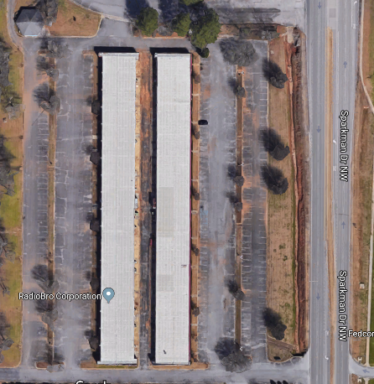
Location and Parking for the
14-15 February 2019
MBSE Tool Expo
Exhibit Hall at The University of Alabama in Huntsville
Sponsored by
The Rotorcraft System Engineering and Simulation Center (RSESC)
https://www.uah.edu/rsesc
Turn into the Executive Plaza and park in the designated area shown above. Parking in two rows away from the building only. Follow the designated path to use the cross walk at Sparkman and proceed to the Theater in AM, Exhibit Hall in PM, entrance on the east side of the building as shown. Parking to Theater a 15 minute walk.
No shuttles will be provided. Drop off passengers at Exhibit Hall is authorized but everyone must park in this designated location. Carpooling is encouraged.

